Slide 1
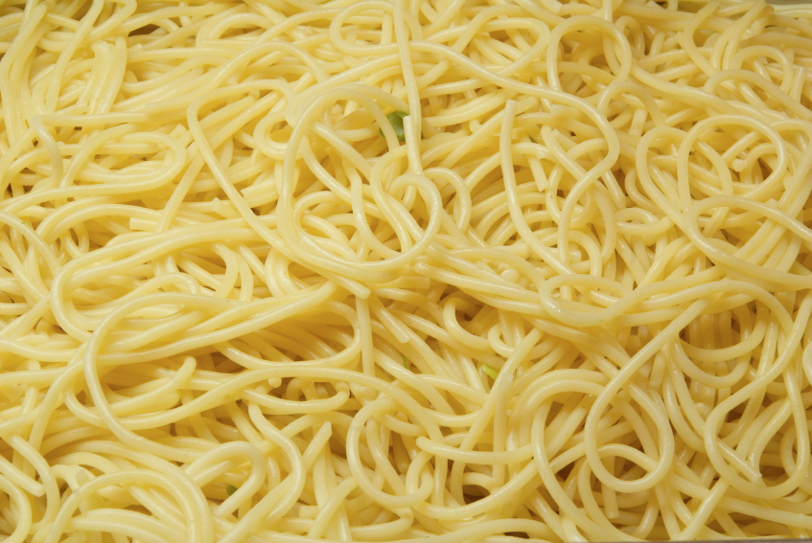
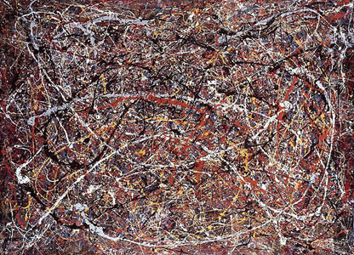
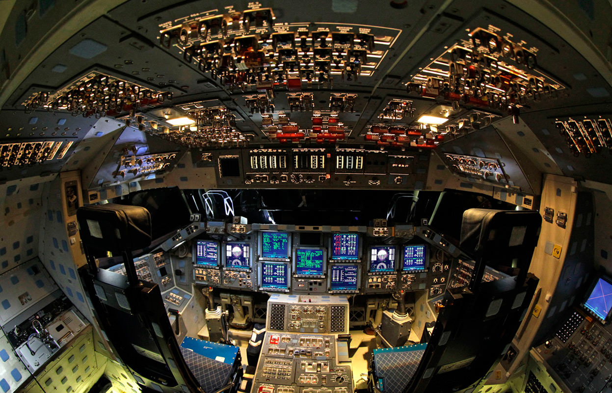
MIRACLE
Dawn Parker, Tatiana Filatova, Michael Barton, Terry Dawson, Gary Polhill, Lorenzo Milazzo, Allen Lee, Ju-Sung Lee, Alexey Voinov, Kirsten Robinson, Xiongbing Jin, Calvin Pritchard

Slide 2
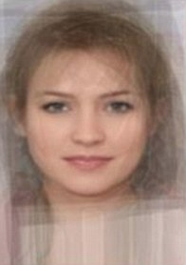
Notes:
Supposedly the ‘average’ face of an English woman (from the Daily Mail)
Modelling that caters for the average is at risk of making the same mistakes as the person creating the average face
Only took pictures of white women in their 20s… (Sexist, Racist, Ageist)

Slide 3
Agent-based modelling
…is computer simulation that explicitly represents individual heterogeneity and interactions
Macro-level phenomena emerge from micro interactions
Notes:
If agent-based modellers were investors, we wouldn’t be chartists

Slide 4
Notes:
Lots of hurdles to jump when learning ABM:
A new way of thinking
Design and representation
Programming
Making multiple runs
Analysing outputs

Slide 5
Notes:
Making sense of data from 000s of runs is challenging, especially for ABMs
big(-ish) data
may not be able to assume normality
complex, multi-dimensional input and output spaces
advanced techniques required
more hurdles

Slide 6
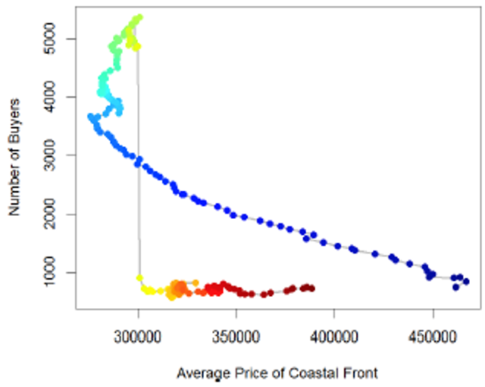
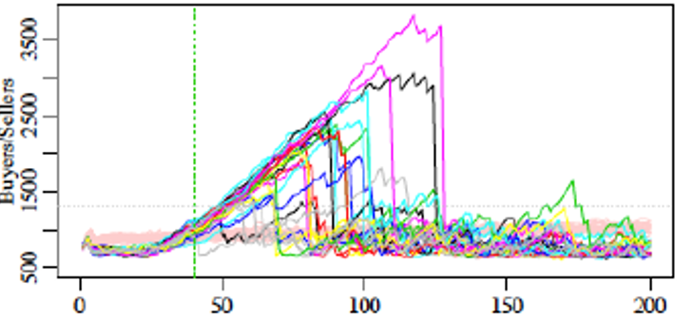
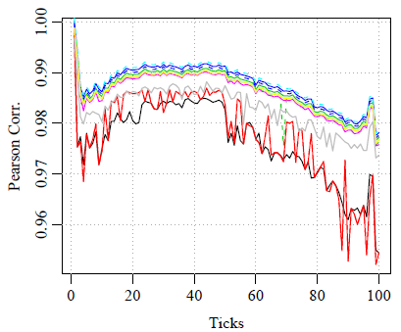
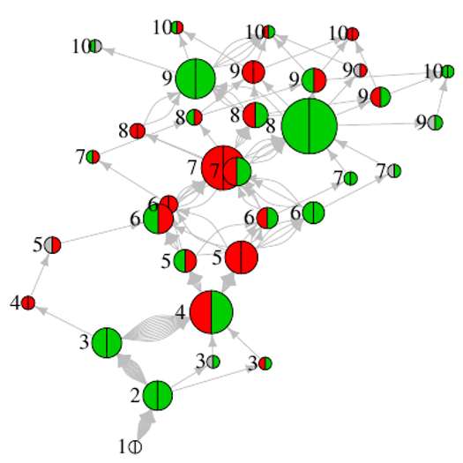
ABM Output Analysis
Tipping Points in ABM Phase Space:
ABM Output Characterized by Dimension Reduction:
ABM Output as Network:
Notes:
Z from upper left:
Each line is separate ABM run, suffers from saturation and crash at tipping point;
Similar data but for one run with two output variables in x and y axes. Colors denote time (blue to red)
Different dimension reductions correlated against true distance matrix of outputs;
Network of discretized state changes for two outcomes.

Slide 7
Notes:
A painting found in a thrift store that may be a Pollock
Worth $5 if not; $10M+ if it is
In science as in art, we need to know how our cultural artefacts are produced
Difference is, in science, we want others to be able to do what we’ve done
Not to mention, remembering what we’ve done years later

Slide 8
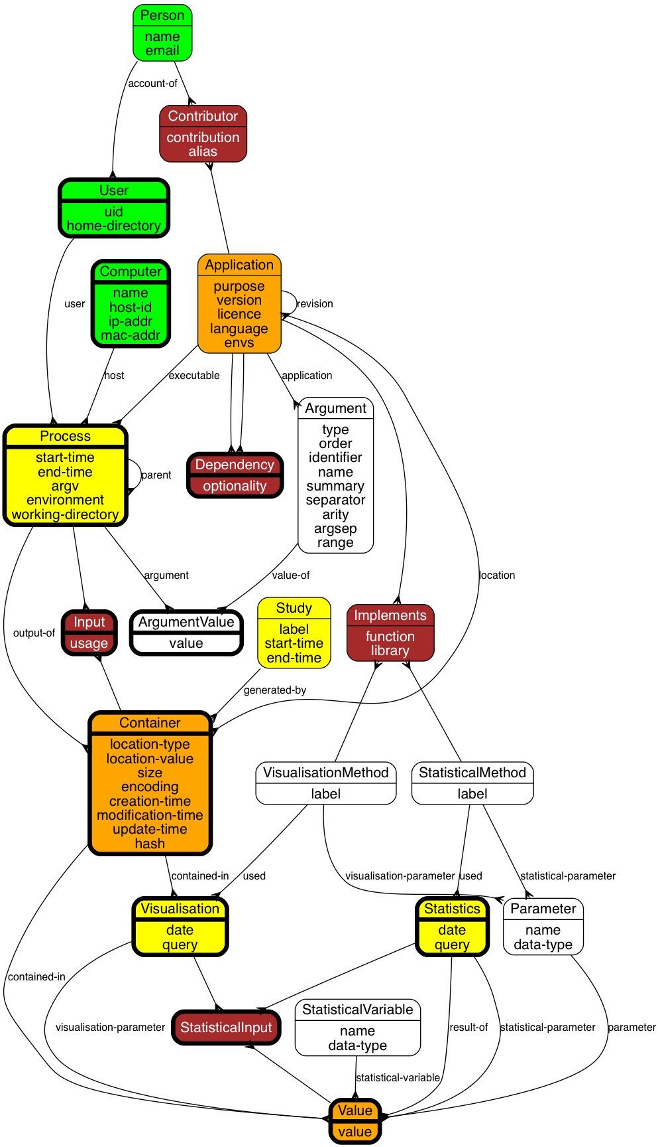
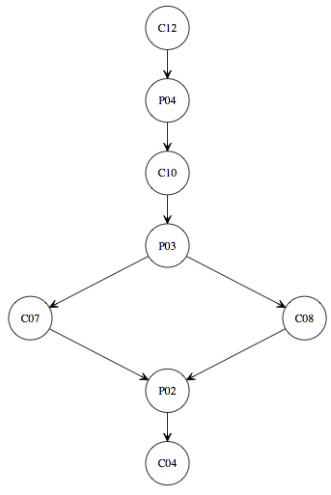
Graph file
generated-by
R script
used
CSV file
generated-by
Shell script
used
used
CSV file
(phase 1)
generated-by
CSV file
(phase 2)
Perl script
used
Notes:
We have initiated creating metadata schemas to support analysis of outputs in social simulation
Graph on the left is the provenance part of that
We have developed prototype tools to help record metadata during the analysis process
Graph on the right shows the provenance data stored as simulation output data are processed to make a graph

Slide 9
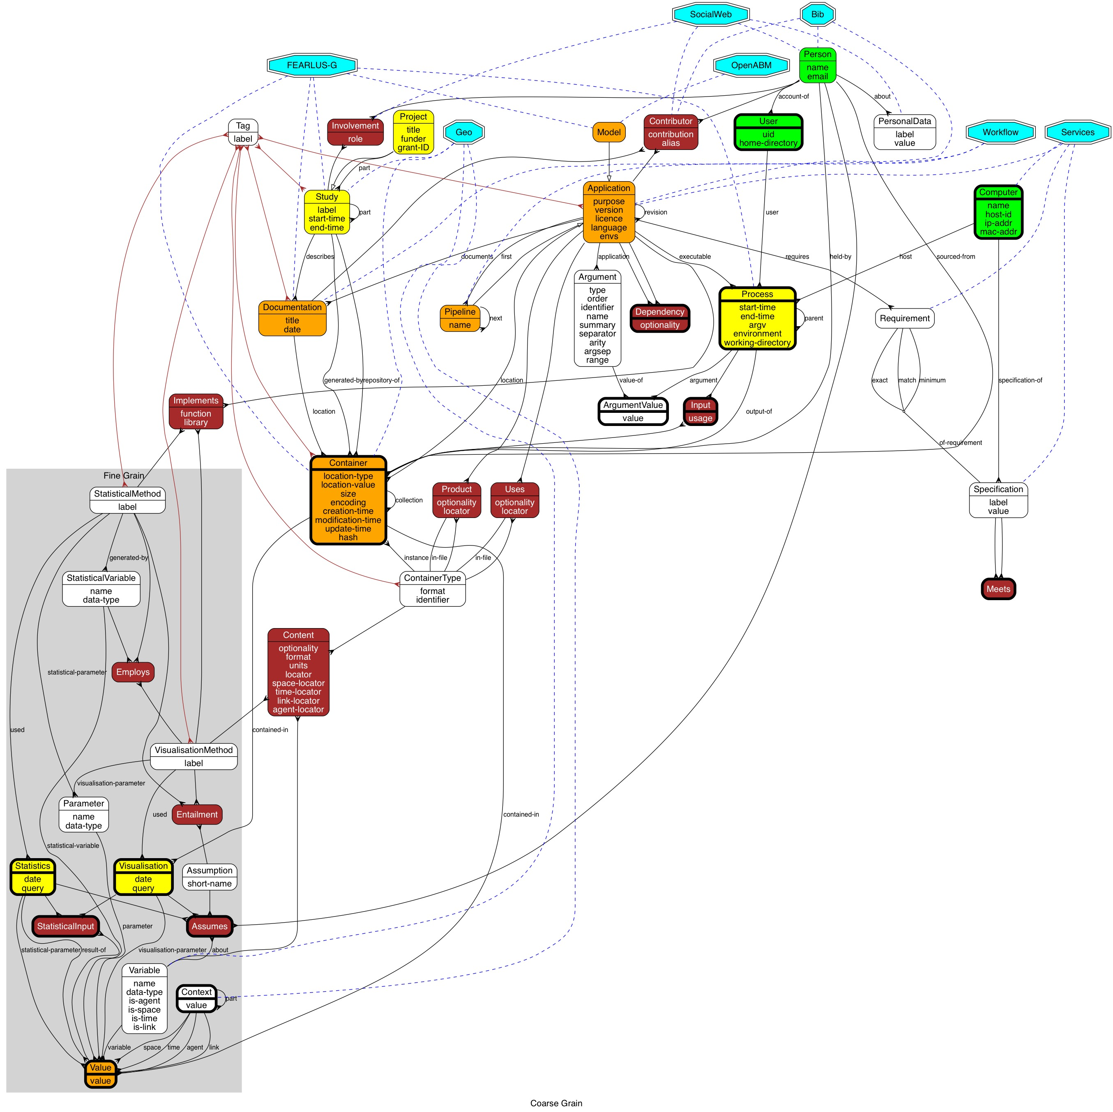
Notes:
Full metadata schema (consider deleting)

Slide 10
Notes:
New analysis and visualisation techniques; and metadata standards need to be easy to use
(Play video)

